Slide 1
Handwriting Digit Recognizer
--Predictive Modelling Project
Group No.7

Slide 2
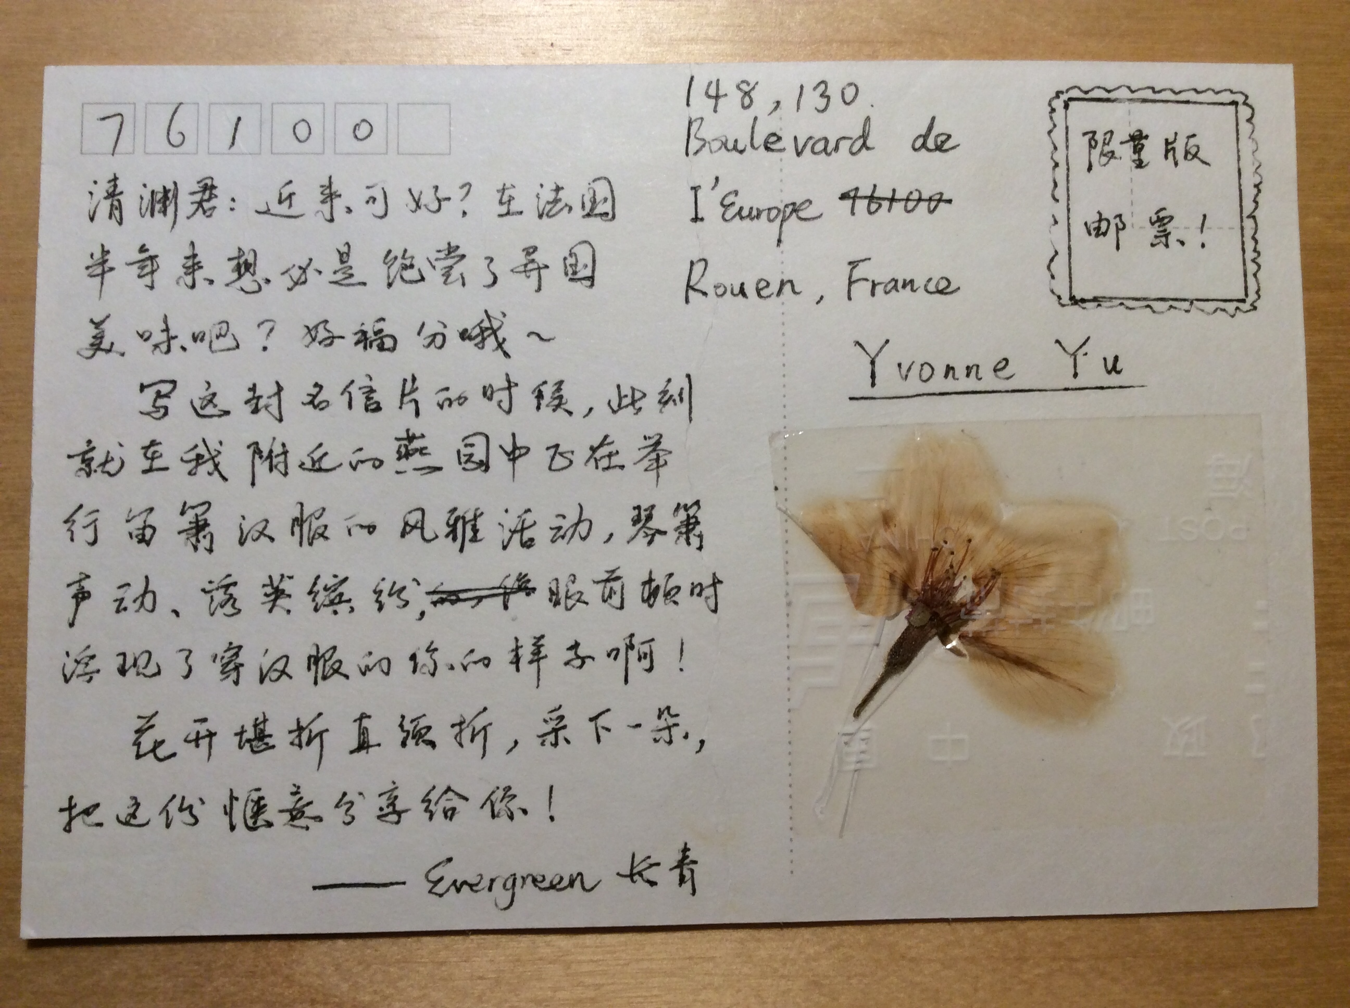
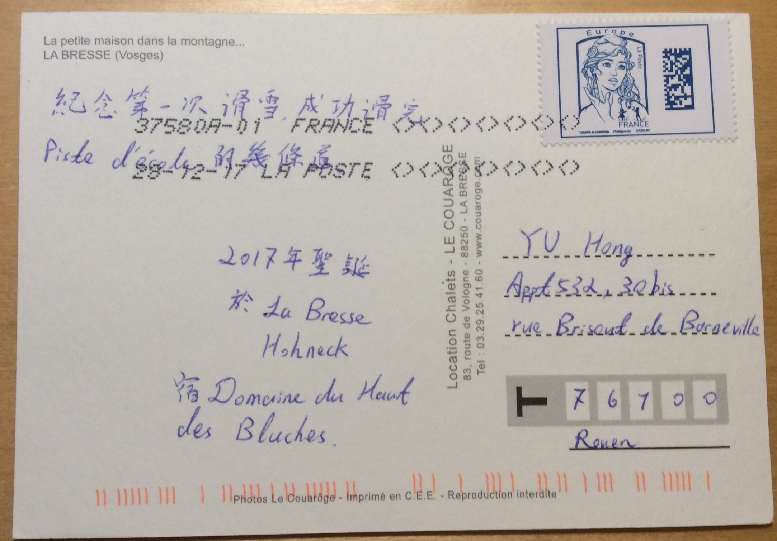
Example of Use Case
Recognition of zip code
Notes:
In the post office, we firstly sort letters not according to the completed address which is too detailed but according to the zip code. Even though, it will take postman a lot of time to read the zip code of each and decide which destination it should be sent to. If the machine can recognize these zip codes, it will economize time and human resource.

Slide 3
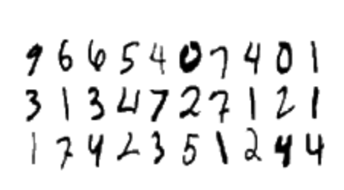
Data Description
42k 28k
train.csv test.csv
784 columns of pixel-value
Prediction
000 001 002 003 ... 026 027
028 029 030 031 ... 054 055
056 057 058 059 ... 082 083
| | | | ... | |
728 729 730 731 ... 754 755
756 757 758 759 ... 782 783
ImageId, Label 1, 3 2, 7 3, 8
……
28 pixels in height
28 pixels in width
Notes:
The data files train.csv and test.csv contain gray-scale images of hand-drawn digits, from zero through nine.
Each image is 28 pixels in height and 28 pixels in width, for a total of 784 pixels. Each pixel has a single pixel-value associated with it, indicating the lightness or darkness of that pixel, with higher numbers meaning darker. This pixel-value is an integer between 0 and 255, inclusive.
The training data set, (train.csv), has 785 columns. The first column, called "label", is the digit that was drawn by the user. The rest of the columns contain the pixel-values of the associated image.
Each pixel column in the training set has a name like pixelx, where x is an integer between 0 and 783, inclusive. To locate this pixel on the image, suppose that we have decomposed x as x = i * 28 + j, where i and j are integers between 0 and 27, inclusive. Then pixelx is located on row i and column j of a 28 x 28 matrix, (indexing by zero).
For example, pixel31 indicates the pixel that is in the fourth column from the left, and the second row from the top, as in the ascii-diagram below.
Visually, if we omit the "pixel" prefix.
The test data set, (test.csv), is the same as the training set, except that it does not contain the "label" column.

Slide 4
Intended Approach
Prepare the calculation platform.
Train Neural Network models to recognize single number.
Test with test set.
Compare models in order to find the best one.
Visualize the result.
* Find multiple-digit data set
* Try using this model to recognize these multiple-digit data
* Recognize the nationality of the writter
Notes:
First of all, we are going to build a platform who can provide enough computing power, and it can be a cloud or distributed system like hadoop
Then, we will focus on the single number, we will train different models.
After that we will test those models with the test set and find the best one which can be used.
Last but not least. We will visualize the result in a web page.
However, After finishing these steps, if we still have enough passion and time.

Slide 5
Group No.7
Benoit
Hong
Jixiong
Model
Analysis + Visualization
Model
Report
Model
Calculation Platform
Notes:
Before starting the project. As a team, we need to split the project in different parts and distribute them to each of us.
First we need to have a suitable model for the classifier, so all of us will train some certain models, and we will select the best one among those models.
After that, Hong will analyze the result and do the visualization
Benoit will be in charge of the reporting.
And for me, I will try to provide a Computing platform for supporting the process of training.

Slide 6
Possible Obstacles
Calculation power of the platform
Understand the NN model
Find the fitted NN model
How to avoid mistakes during digits localization

